Slide 1


Alexa Skills

Slide 2


ACROPOLIS INSTITUDE OF TECHNOLOGY AND RESEARCH
SUBMITED TO SUBMITED BY
Nidhi Nigam Mihir Joshi

Slide 3
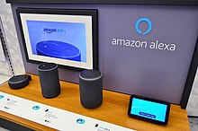
About Alexa
A virtual assistant technology largely based on a Polish speech synthesiser named Ivona, bought by Amazon in 2013.It was first used in the Amazon Echo smart speaker and the Echo Dot, Echo Studio and Amazon Tap speakers developed by Amazon Lab126. It is capable of voice interaction, music playback, making to-do lists, setting alarms, streaming podcasts, playing audiobooks, and providing weather, traffic, sports, and other real-time information, such as news. Alexa can also control several smart devices using itself as a home automation system. Users are able to extend the Alexa capabilities by installing "skills" (additional functionality developed by third-party vendors, in other settings more commonly called apps) such as weather programs and audio features. It uses automatic speech recognition, natural language processing, and other forms of weak AI to perform these tasks.

Slide 4


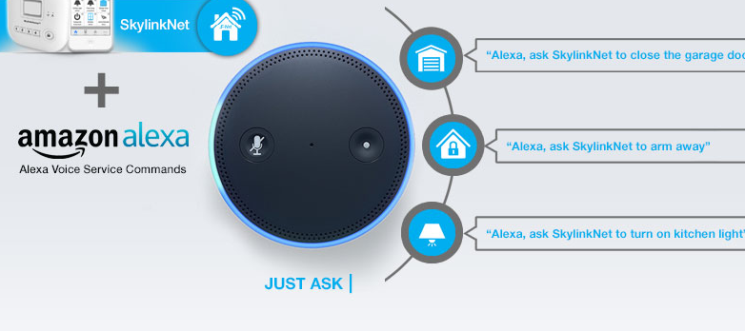
What is Alexa Skill Set

Slide 5
For developing an alexa skills we are using voice flow website

Slide 6

What is voiceflow

Slide 7
Conversational AI product teams use Voiceflow to design, test, and ship chat and voice assistants- together, faster, at scale.Voiceflow is the modern creative platform for teams that are conversation design oriented and product driven. Voiceflow unifies the design and prototyping workflow whilst making design-dev handoff, or launching live experiences, easy. We felt this problem in 2018, when building our own conversational apps, and set out to solve it with Voiceflow.

Slide 8
How to use voiceflow

Slide 9
How to Develop our own alexa skills
We are using a website called voiceflow.com for creating alexa
Here are the main stpes for creating an alexa skills
Acount creation
Log in
01
Frst of all we have to create a account on voiceflow website
02
Here we have lon in on the voiceflow website
Select Intrest
Create Skill
03
Select that what skill you have to work upon like chat , voice or alexa
04
Now you can create any alexa skills

Slide 10
Terminolodgy used in voiceflow
Intent=To create your custom interaction model, you create the intents, slots, and sample utterances for your skill. An intent represents an action that fulfills a user's spoken request. Intents can optionally have arguments called slots. The sample utterances are set of likely spoken phrases mapped to the intents.
Uttrences=The sample utterances are set of likely spoken phrases mapped to the intents. For details and code examples that show how you access intents and slots sent in user requests during skill runtime, see Handle Requests Sent by Alexa.

Slide 11
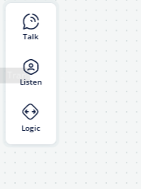
After login in voiceflow you will see a three buttons on the left side they are:-
01
Test
02
Listen
03
Logic

Slide 12
Talk
There are mainly five button in talk
1.Speak-Use to add speak varieant
2.Audio-Use to take audio input from user.
3.Display-Use to display the images(if any).
4.Card-Use to provide some on-screen information in-line
5.Stream

Slide 13
Listen
There are mainly two options in Listen
1.Capture:-It is use to capture an intent.
2.Choice:-It is use to select any one input from the multiple inputs present

Slide 14
Logic
There are five buttons
1.Conditions:-It is used to five if else condition.
2.Set:-Use to crete a collection of the data
3.Random:-Use to select any of the data automatically.
4.Compenent:-We can write a code in javascript.
5.End:-This will termianted the skill.

Slide 15


STUDIO SHODWE
Thank You
SLIDE PRESENTATIONS DESIGN

